Slide 1
Linear DP

Slide 2
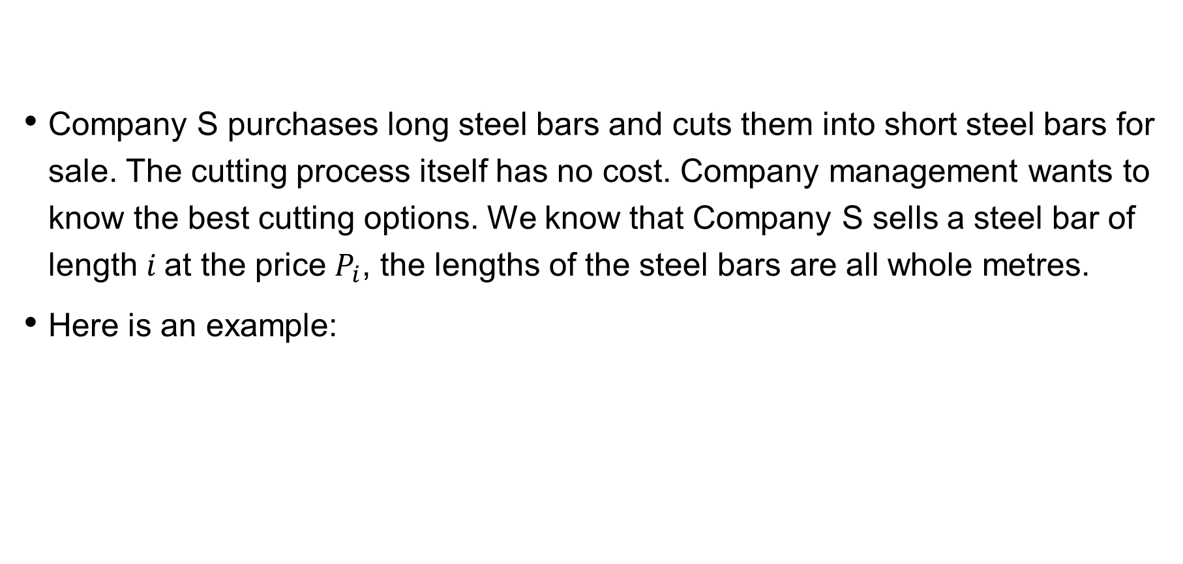
Steel bar cutting
Company S purchases long steel bars and cuts them into short steel bars for sale. The cutting process itself has no cost. Company management wants to know the best cutting options. We know that Company S sells a steel bar of length $i$at the price $P_{i}$, the lengths of the steel bars are all whole metres.
Here is an example:

Slide 3
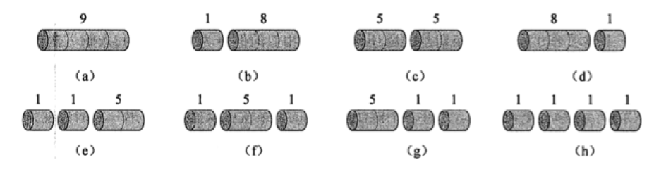

Steel bar cutting
Consider $n=4$, the following are all possible cutting options of a $4$metre steel bar, including not cutting at all. We found that cutting a $4$ metre long steel bar into two sections of $2$ metre long steel bars will generate revenue of $5+5=10$, which is the optimal solution.

Slide 4
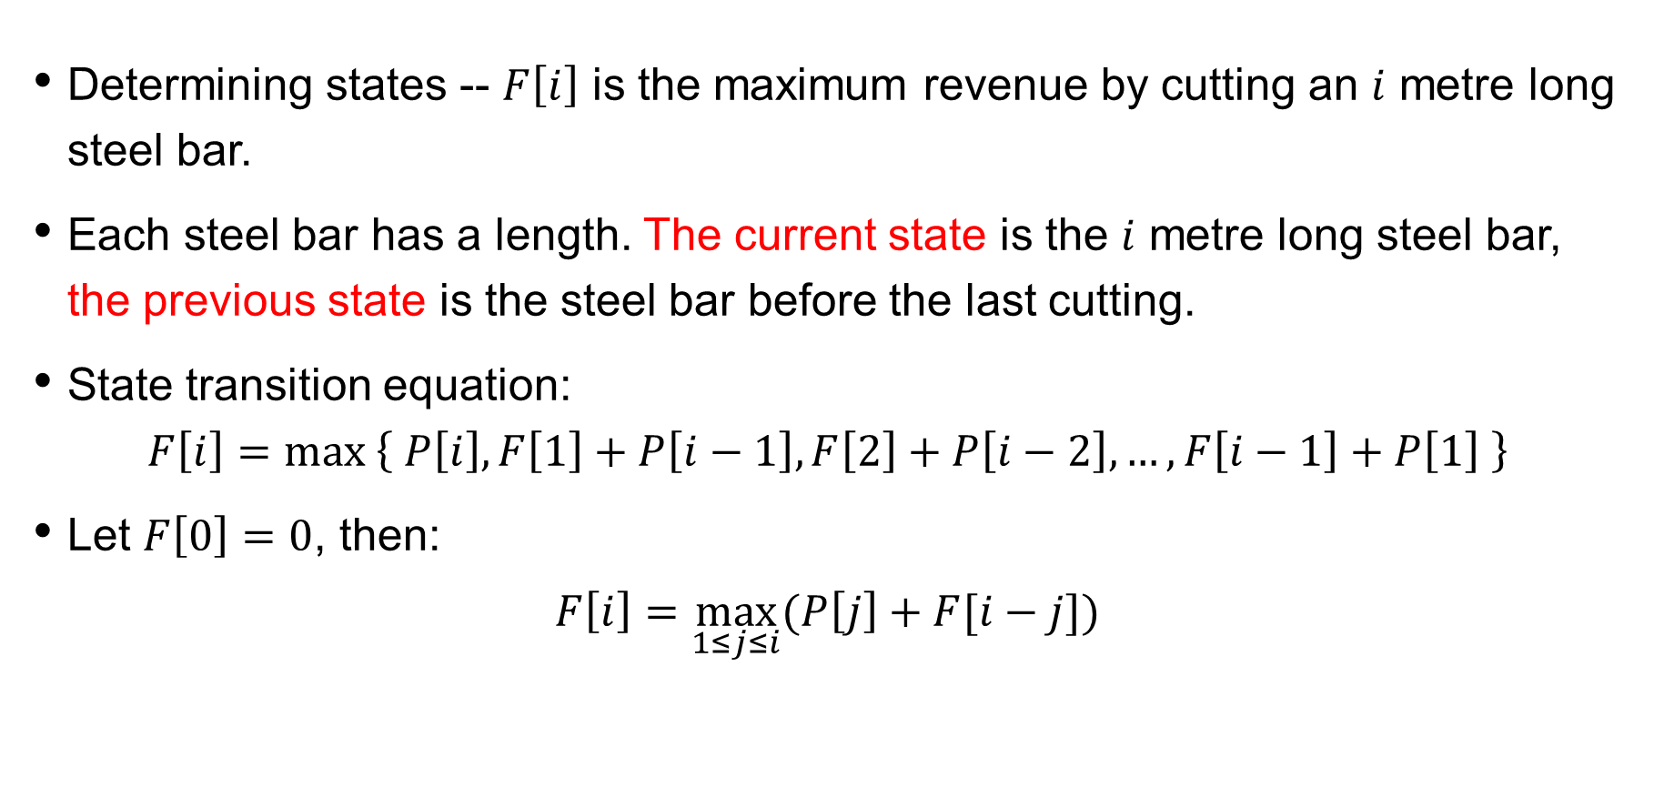
Steel bar cutting
Determining states -- $F\left[i\right]$ is the maximum revenue by cutting an $i$ metre long steel bar.
Each steel bar has a length. The current state is the $i$ metre long steel bar, the previous state is the steel bar before the last cutting.
State transition equation:
$$F\left[i\right]=max \left\{ P\left[i\right], F\left[1\right]+P\left[i−1\right],F\left[2\right]+P\left[i−2\right],…,F\left[i−1\right]+P\left[1\right] \right\}$$
Let $F\left[0\right]=0$, then:
$$F\left[i\right]=\max_{1≤j≤i}{(P\left[j\right]+F[i−j])}$$

Slide 5
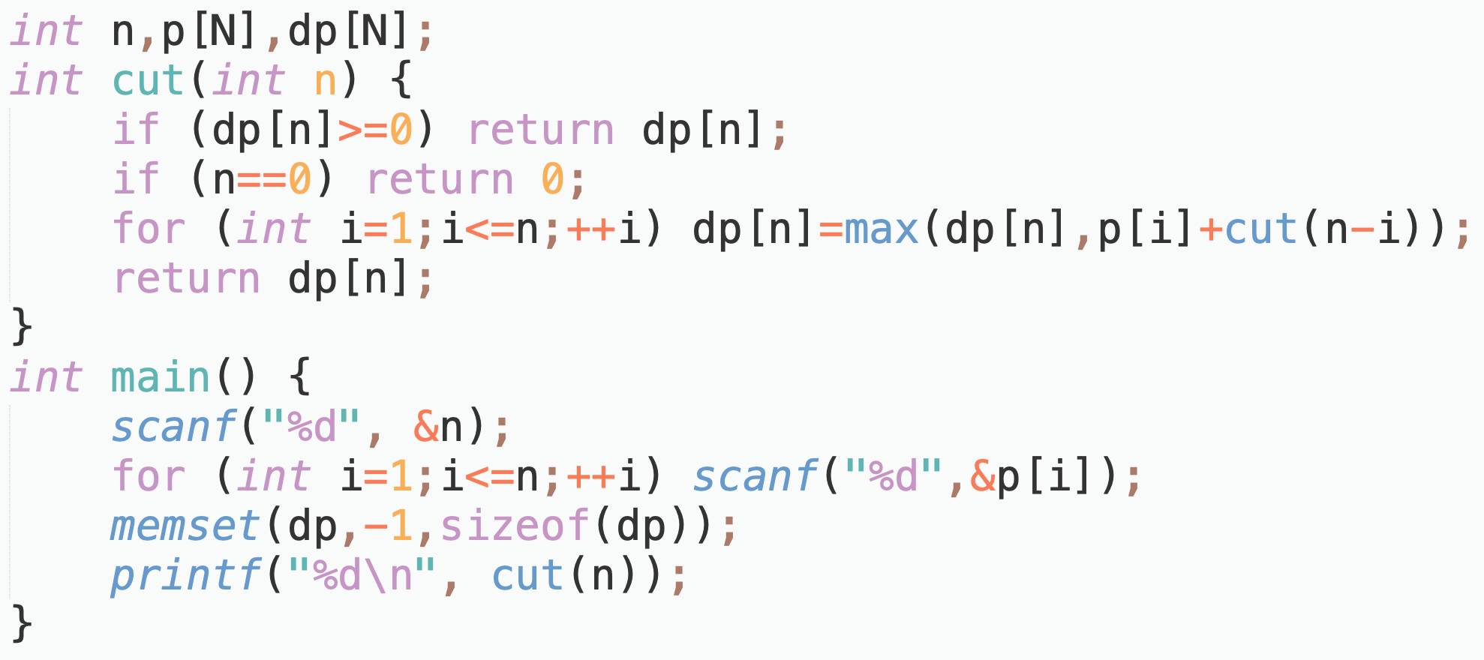
Steel bar cutting
Memoised search:

Slide 6
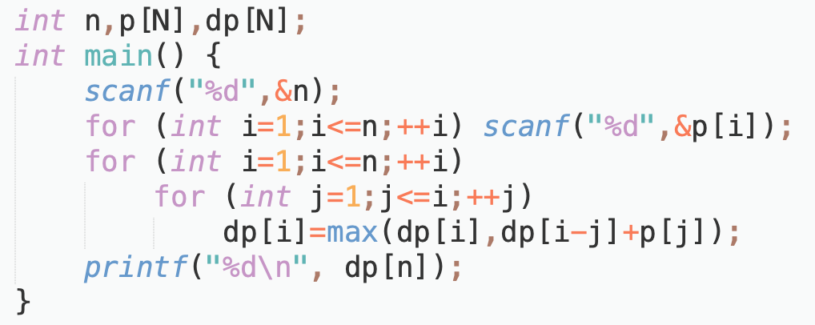
Recurrence code

Slide 7
Missile Interceptor ( NOIP 1999 )
In order to defend against enemy missile attacks, a country developed a missile interception system. But this system has a flaw: although its first shell can reach any height, each subsequent shell cannot reach higher than the previous one. One day, the radar detected incoming missiles from an enemy country. Since there is only one functional system, it may not be able to intercept all missiles.
Provided the height at which each missile fly, calculate the maximum number of missiles this system can intercept.

Slide 8
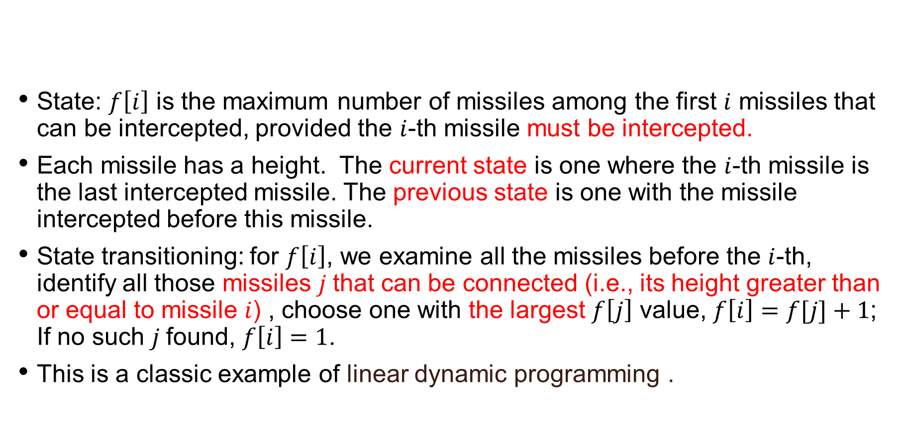
determining states
State: $f\left[i\right]$ is the maximum number of missiles among the first $i$ missiles that can be intercepted, provided the $i$-th missile must be intercepted.
Each missile has a height. The current state is one where the $i$-th missile is the last intercepted missile. The previous state is one with the missile intercepted before this missile.
State transitioning: for $f\left[i\right]$, we examine all the missiles before the $i$-th, identify all those missiles $j$that can be connected (i.e., its height greater than or equal to missile $i$) , choose one with the largest $f\left[j\right]$ value, $f\left[i\right]=f[j]+1$; If no such $j$found, $f\left[i\right]=1$.
This is a classic example of linear dynamic programming .

Slide 9
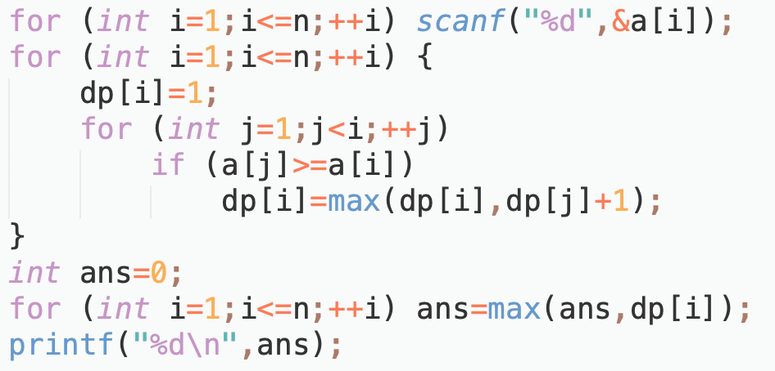
code

Slide 10
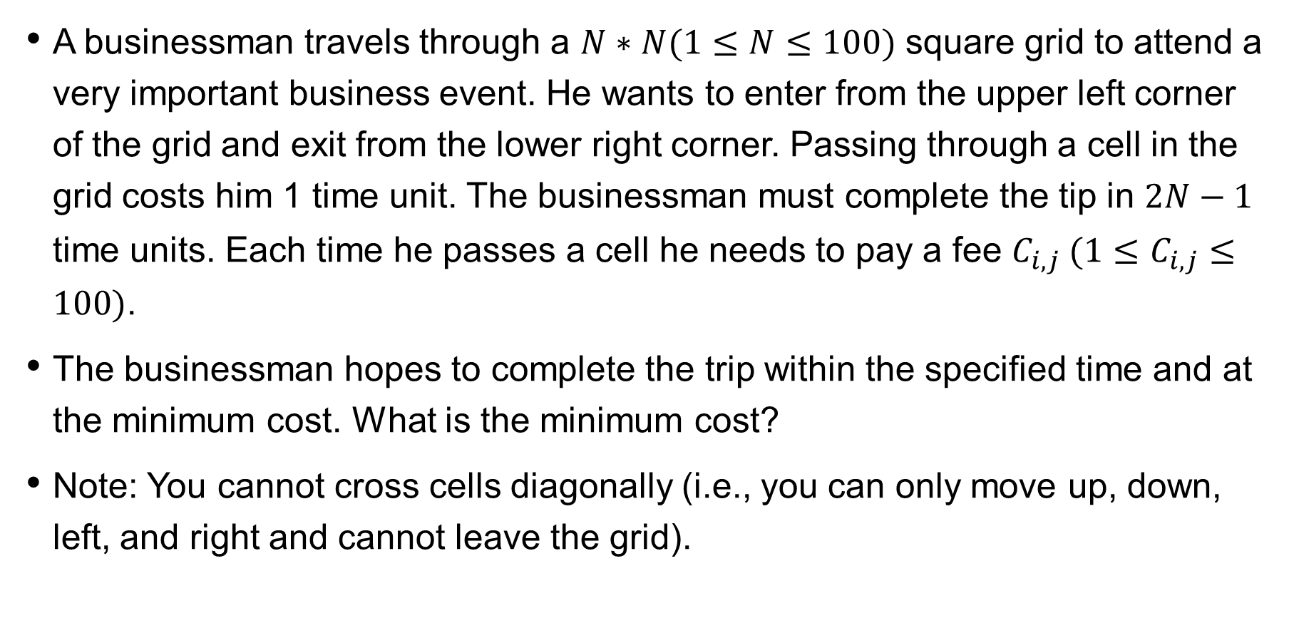
minimum toll
A businessman travels through a $N∗N(1≤N≤100)$ square grid to attend a very important business event. He wants to enter from the upper left corner of the grid and exit from the lower right corner. Passing through a cell in the grid costs him 1 time unit. The businessman must complete the tip in $2N−1$ time units. Each time he passes a cell he needs to pay a fee $C_{i,j} (1≤C_{i,j}≤100)$.
The businessman hopes to complete the trip within the specified time and at the minimum cost. What is the minimum cost?
Note: You cannot cross cells diagonally (i.e., you can only move up, down, left, and right and cannot leave the grid).

Slide 11
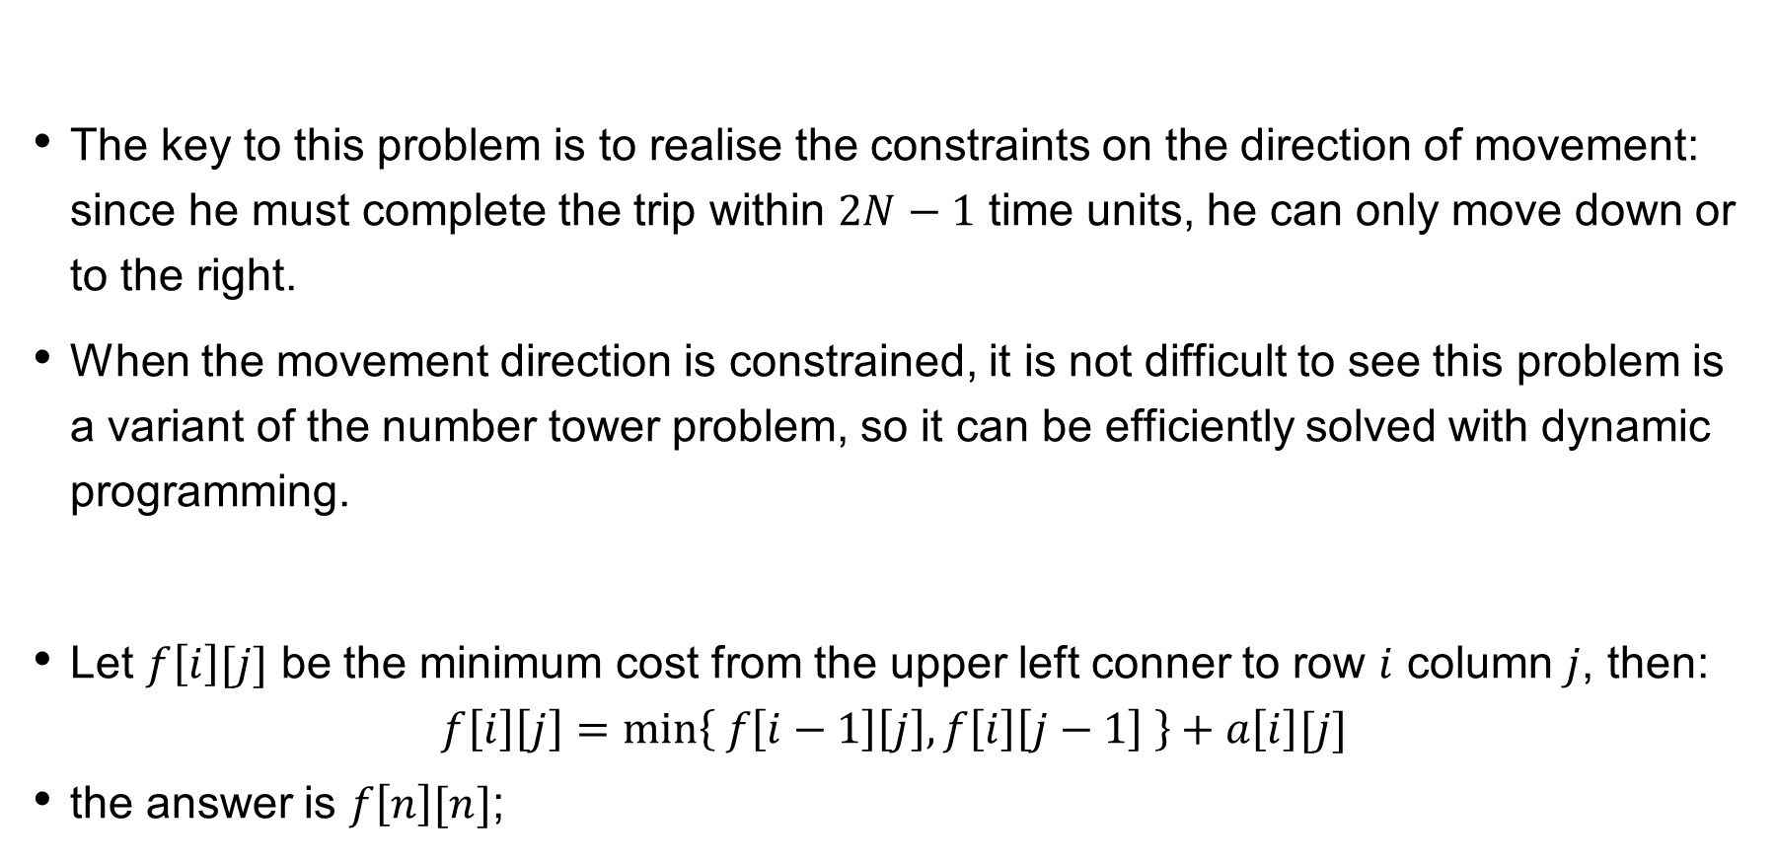
minimum toll
The key to this problem is to realise the constraints on the direction of movement: since he must complete the trip within $2N−1$ time units, he can only move down or to the right.
When the movement direction is constrained, it is not difficult to see this problem is a variant of the number tower problem, so it can be efficiently solved with dynamic programming.
Let $f\left[i\right][j]$ be the minimum cost from the upper left conner to row $i$ column $j$, then:
$$f\left[i\right]\left[j\right]=min\left\{ f\left[i−1\right]\left[j\right], f\left[i\right]\left[j−1\right] \right\}+a\left[i\right][j]$$
the answer is $f\left[n\right][n]$;

Slide 12
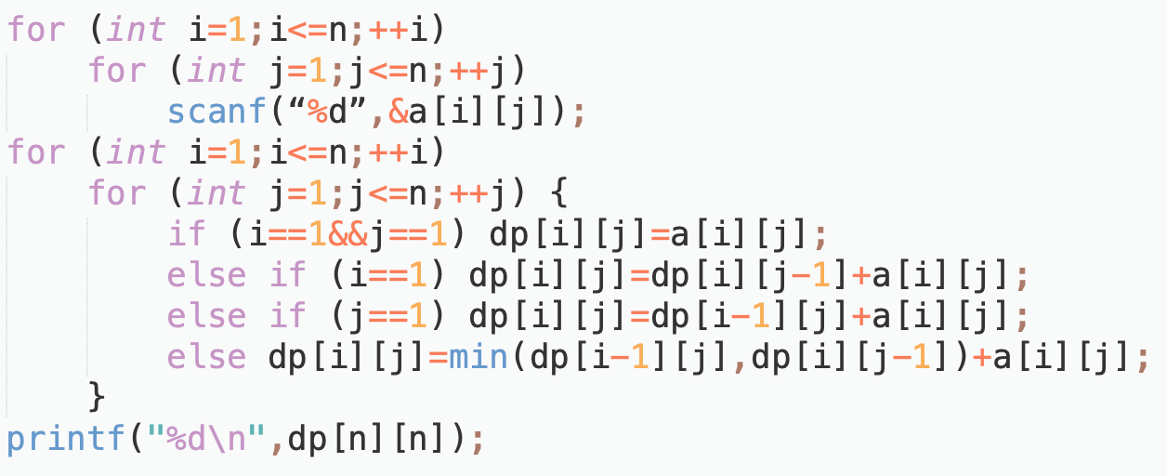
code

Slide 13
Maximum product
There is a string of N( N ≤ 40 ) number digits. You are required to use M ( M ≤ 6 ) multiplication signs to divide them into M + 1 numbers, find a such a way of dividing that maximises the product of these M + 1 numbers.
Example:
There is a string of 312. when N = 3, M = 1, there are two ways:
⑴ 3 × 12 = 36
⑵ 31 × 2 = 62
The result is: 31 × 2 = 62. Please help your friend XZ design a program to find the correct answer.

Slide 14
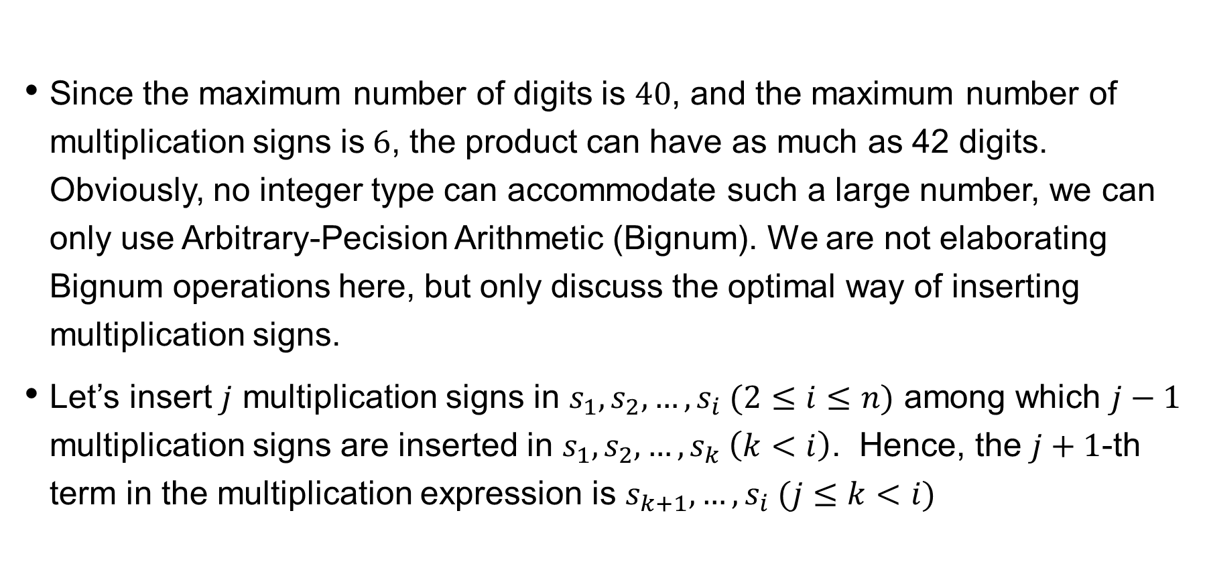
analysis
Since the maximum number of digits is $40$, and the maximum number of multiplication signs is$6$, the product can have as much as 42 digits. Obviously, no integer type can accommodate such a large number, we can only use Arbitrary-Pecision Arithmetic (Bignum). We are not elaborating Bignum operations here, but only discuss the optimal way of inserting multiplication signs.
Let’s insert $j$ multiplication signs in $s_{1},s_{2},…,s_{i} (2≤i≤n)$ among which $j−1$ multiplication signs are inserted in $s_{1},s_{2},…,s_{k} \left(k<i\right)$. Hence, the $j+1$-th term in the multiplication expression is $s_{k+1},…,s_{i} (j≤k<i)$

Slide 15
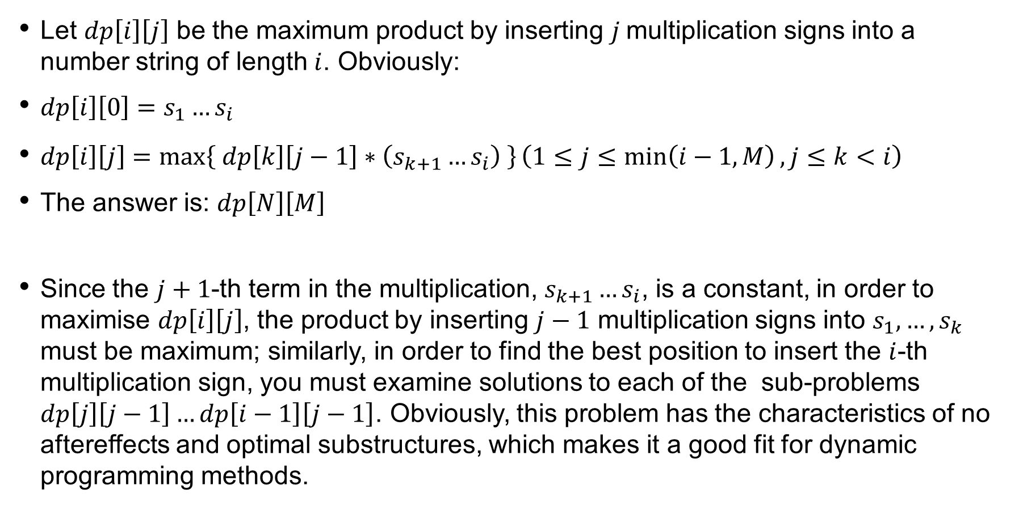
Determining states
Let $dp\left[i\right]\left[j\right]$ be the maximum product by inserting $j$multiplication signs into a number string of length $i$. Obviously:
$dp\left[i\right]\left[0\right]=s_{1}…s_{i}$
$dp\left[i\right]\left[j\right]=\max\left\{ dp\left[k\right]\left[j−1\right]∗\left(s_{k+1}…s_{i}\right) \right\}\left(1≤j≤\min\left(i−1,M\right), j≤k<i\right)$
The answer is: $dp\left[N\right]\left[M\right]$
Since the $j+1$-th term in the multiplication, $s_{k+1}…s_{i}$, is a constant, in order to maximise $dp\left[i\right]\left[j\right]$, the product by inserting $j−1$ multiplication signs into $s_{1},…,s_{k}$ must be maximum; similarly, in order to find the best position to insert the $i$-th multiplication sign, you must examine solutions to each of the sub-problems $dp\left[j\right]\left[j−1\right]…dp\left[i−1\right]\left[j−1\right]$. Obviously, this problem has the characteristics of no aftereffects and optimal substructures, which makes it a good fit for dynamic programming methods.

Slide 16
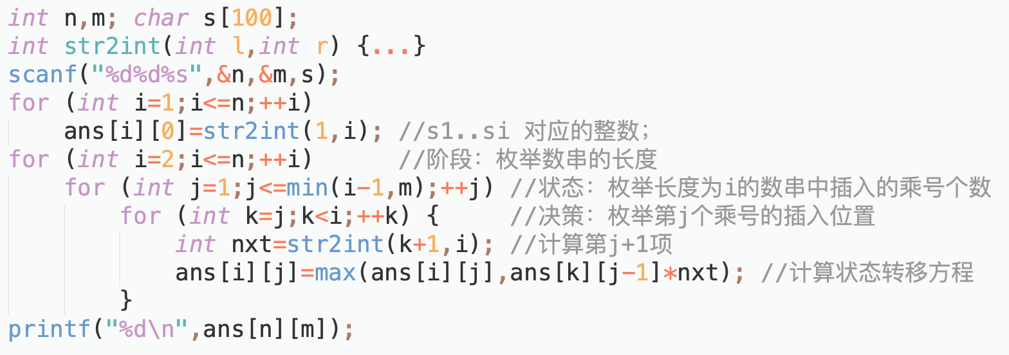
pseudocode

Slide 17
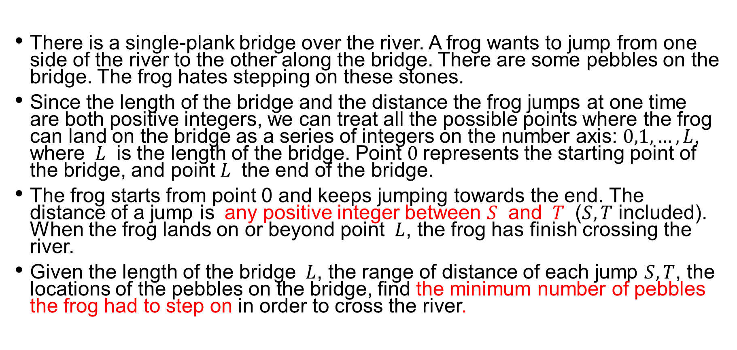
crossing the river
There is a single-plank bridge over the river. A frog wants to jump from one side of the river to the other along the bridge. There are some pebbles on the bridge. The frog hates stepping on these stones.
Since the length of the bridge and the distance the frog jumps at one time are both positive integers, we can treat all the possible points where the frog can land on the bridge as a series of integers on the number axis: $0,1,…,L$, where $L$ is the length of the bridge. Point $0$represents the starting point of the bridge, and point $L$ the end of the bridge.
The frog starts from point 0 and keeps jumping towards the end. The distance of a jump is any positive integer between $S$ and $T$ ($S,T$ included). When the frog lands on or beyond point $L$, the frog has finish crossing the river.
Given the length of the bridge $L$, the range of distance of each jump $S,T$, the locations of the pebbles on the bridge, find the minimum number of pebbles the frog had to step on in order to cross the river.

Slide 18
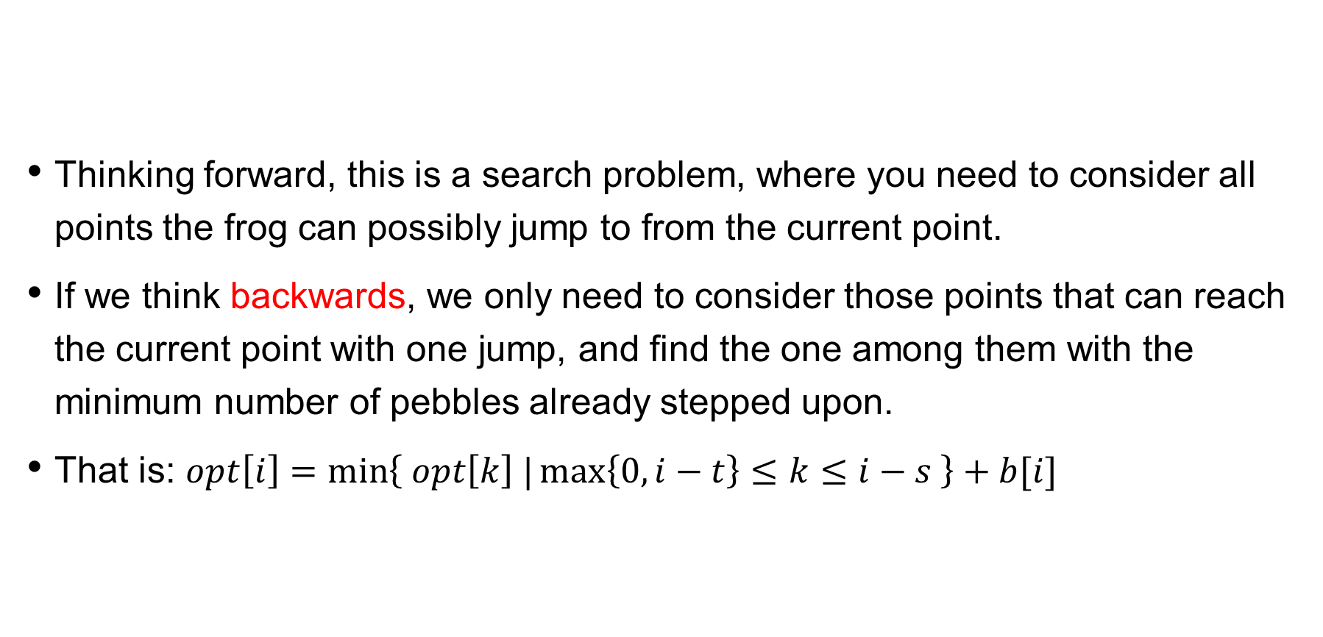
analysis
Thinking forward, this is a search problem, where you need to consider all points the frog can possibly jump to from the current point.
If we think backwards, we only need to consider those points that can reach the current point with one jump, and find the one among them with the minimum number of pebbles already stepped upon.
That is: $opt\left[i\right]=\min\left\{ opt\left[k\right] |\max\left\{0,i−t\right\}≤k≤i−s \right\}+b[i]$

Slide 19
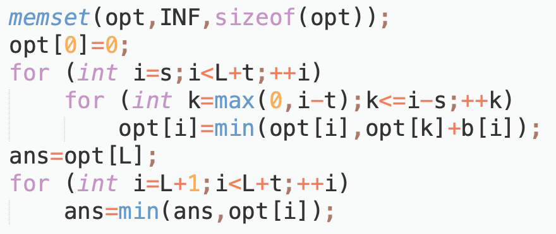
code

Slide 20
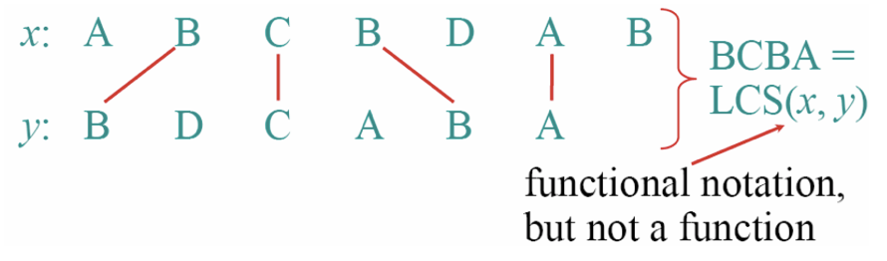

longest common subsequence
Given two sequences $x_{1},x_{2},…,x_{m}$ and $y_{1},y_{2},…,y_{n}$, find the longest common subsequence of these two sequences, marked as $LCS(x,y)$, the length $|LCS\left(x,y\right)|$.

Slide 21
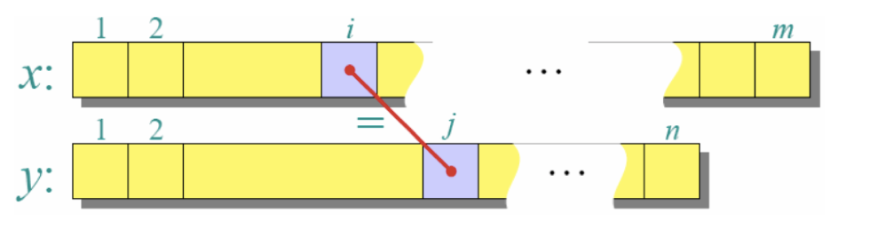

longest common subsequence
Let $f\left[i,j\right]$ be the $|LCS|$ of $x_{1},x_{2},…,x_{i}$ and $y_{1},y_{2},…,y_{j}$, the state transition equation is:
$$f\left[i,j\right]=\left\{\begin{aligned}f\left[i−1,j−1\right]+1 if x\left[i\right]=y[j] \\ \max\left\{ f\left[i−1,j\right], f\left[i,j−1\right] \right\} else\end{aligned}\right.$$

Slide 22
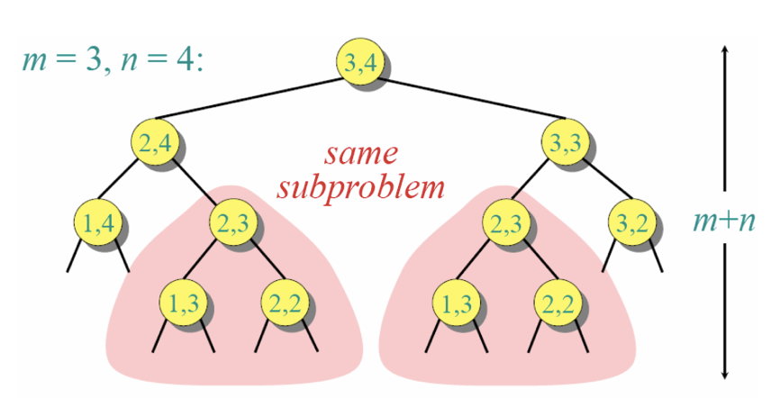
longest common subsequence
Overlapping subproblems: A recursive solution contains many independent subproblems that require repeated calculations.

Slide 23
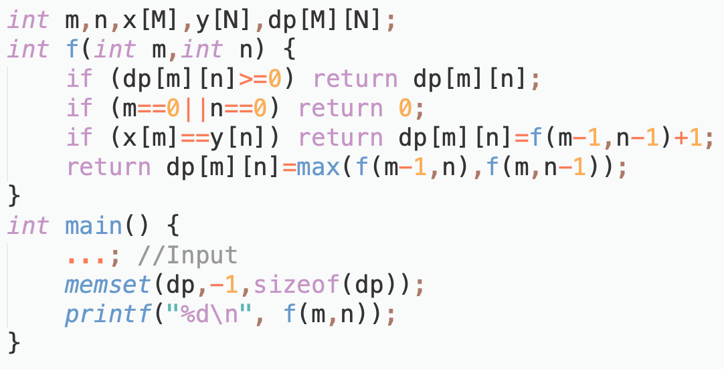
Memoized search

Slide 24
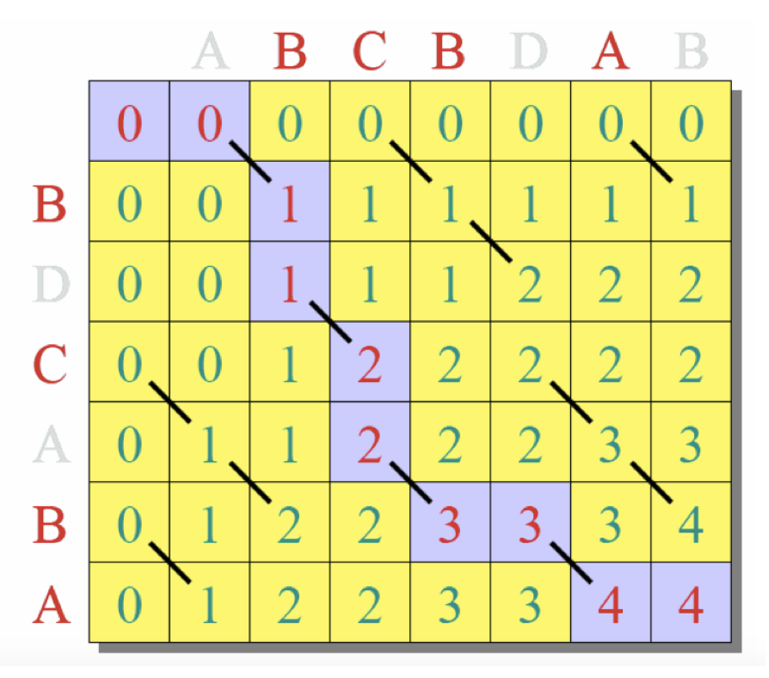
Recurrence

Slide 25
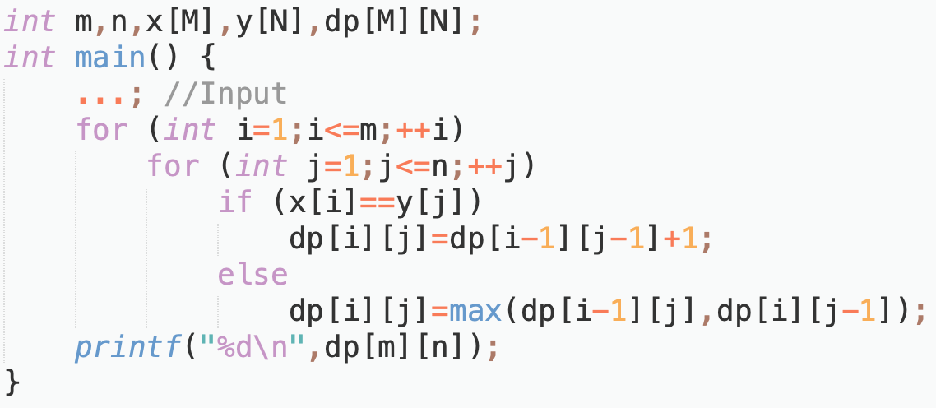
Recurrence

Slide 26
Recurrence
Using rolling array to optimise space
Can further optimise to a one-dimensional array

Slide 27
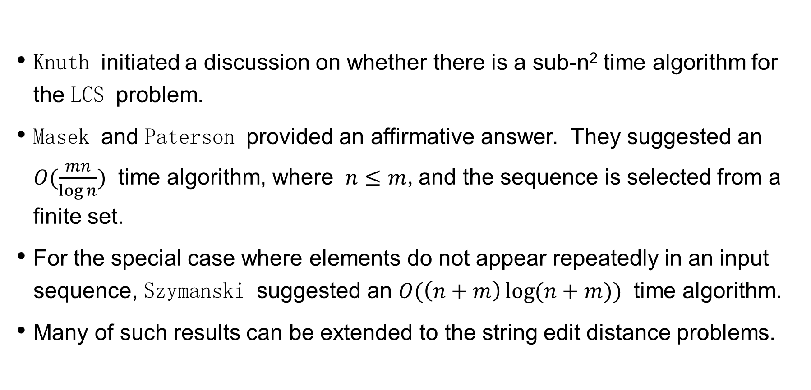
Further optimisation?
Knuth initiated a discussion on whether there is a sub-n² time algorithm for the LCS problem.
Masek and Paterson provided an affirmative answer. They suggested an $O(\frac{mn}{\log{n}})$ time algorithm, where $n≤m$,and the sequence is selected from a finite set.
For the special case where elements do not appear repeatedly in an input sequence, Szymanski suggested an $O(\left(n+m\right)\log{(n+m)})$ time algorithm.
Many of such results can be extended to the string edit distance problems.

Slide 28
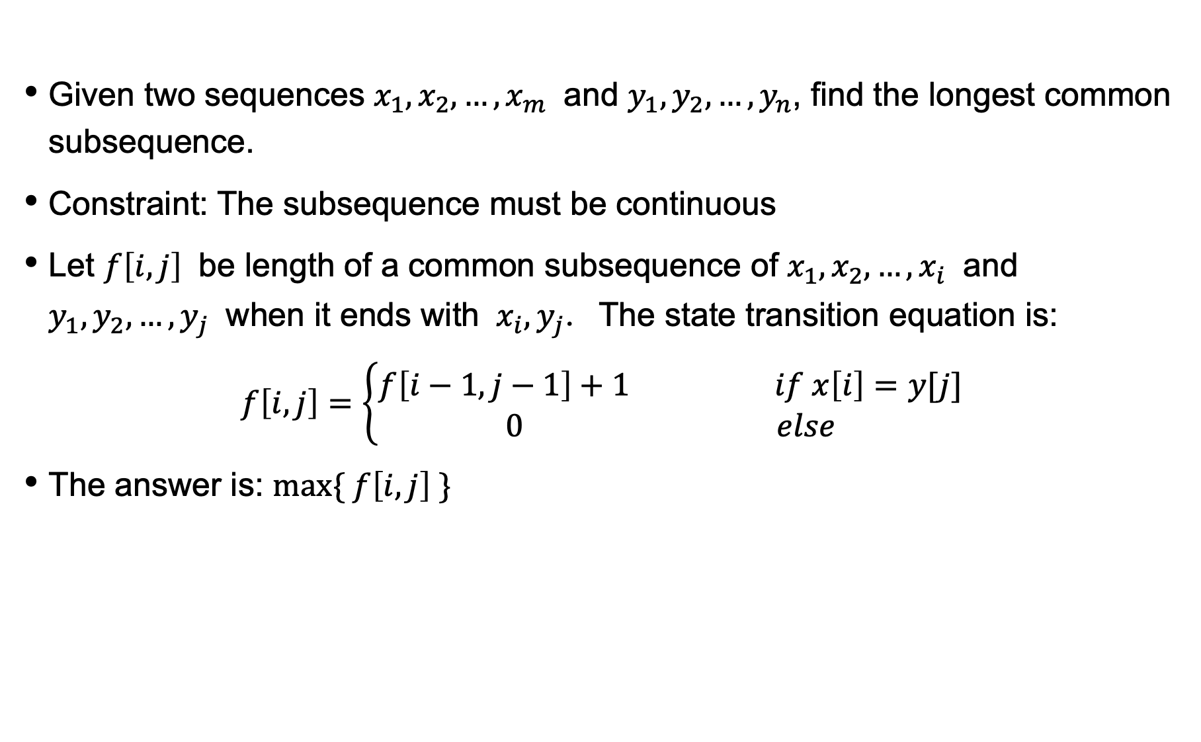
longest common substring
Given two sequences $x_{1},x_{2},…,x_{m}$ and $y_{1},y_{2},…,y_{n}$, find the longest common subsequence.
Constraint: The subsequence must be continuous
Let $f\left[i,j\right]$ be length of a common subsequence of $x_{1},x_{2},…,x_{i}$ and $y_{1},y_{2},…,y_{j}$ when it ends with $x_{i},y_{j}$. The state transition equation is:
$$f\left[i,j\right]=\left\{\begin{aligned}f\left[i−1,j−1\right]+1 if x\left[i\right]=y[j] \\ 0 else\end{aligned}\right.$$
The answer is: $max\{ f\left[i,j\right] \}$

Slide 29
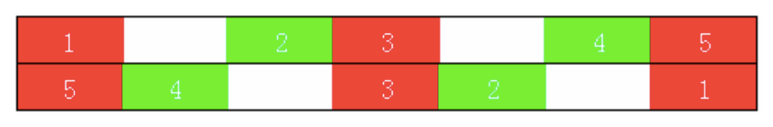
palindrome
Given a character string A, keeping the order of the original characters unchanged, at least how many characters must be added to turn it into a palindrome?
Example : abfcbfa -> afbcfcbfa
Red and green characters represent originals, white represent new characters.
Obviously, it's impossible to be ‘white’ both in the original and reverse strings (otherwise it’s not necessary to add that character in the first place)
There should be as many red characters as possible! This is equivalent to finding the LCS of a string and its reverse string .

Slide 30
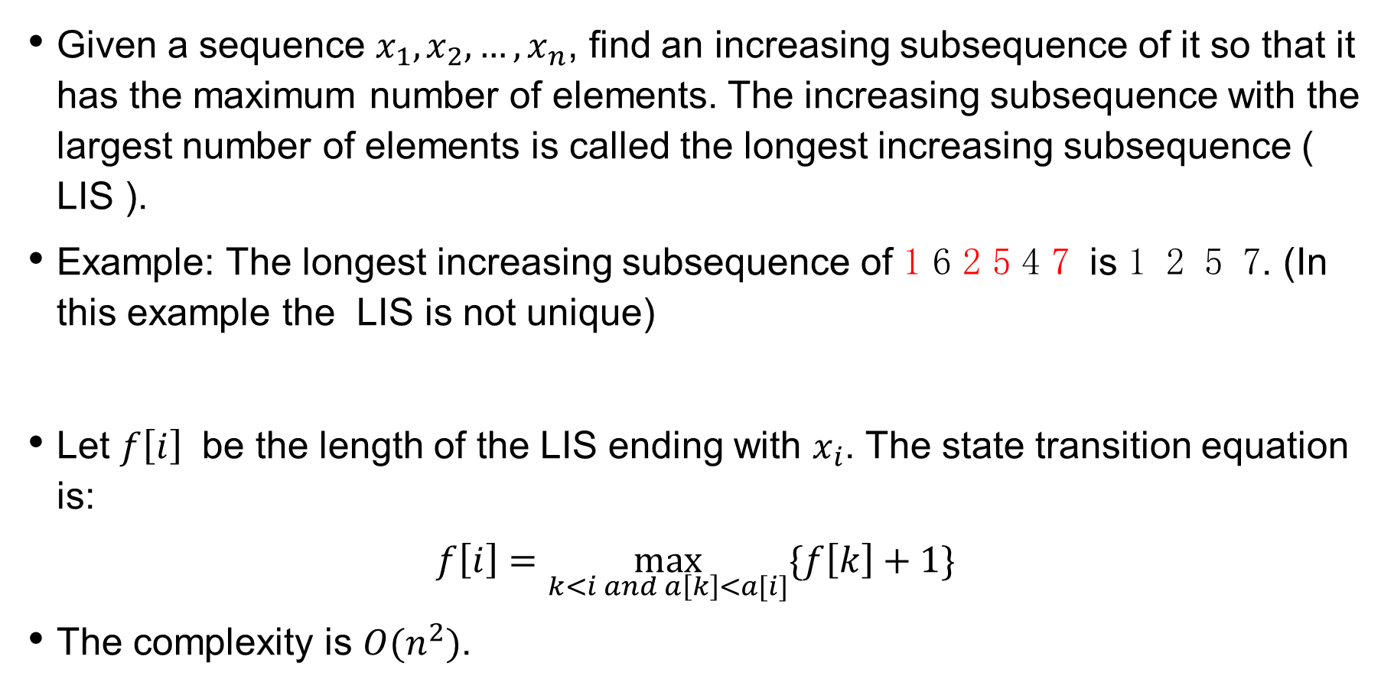
Longest increasing subsequence ( LIS )
Given a sequence $x_{1},x_{2},…,x_{n}$, find an increasing subsequence of it so that it has the maximum number of elements. The increasing subsequence with the largest number of elements is called the longest increasing subsequence ( LIS ).
Example: The longest increasing subsequence of 1 6 2 5 4 7 is 1 2 5 7. (In this example the LIS is not unique)
Let $f\left[i\right]$ be the length of the LIS ending with $x_{i}$. The state transition equation is:
$$f\left[i\right]=\max_{k<i and a\left[k\right]<a[i]}{\{f\left[k\right]+1\}}$$
The complexity is $O(n^{2})$.

Slide 31
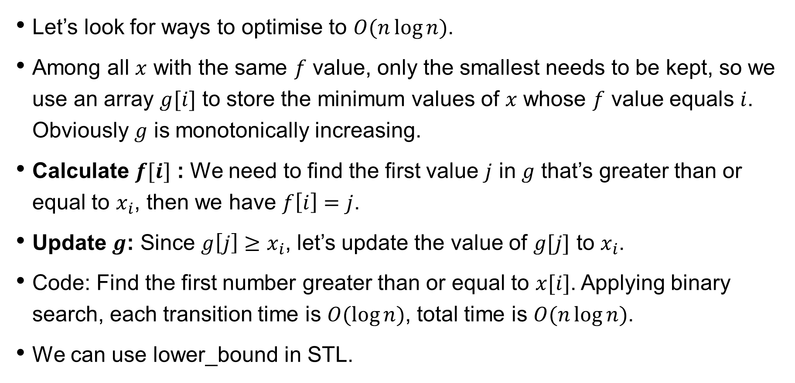
Longest increasing subsequence ( LIS )
Let’s look for ways to optimise to $O(n\log{n})$.
Among all $x$ with the same $f$ value, only the smallest needs to be kept, so we use an array $g[i]$ to store the minimum values of $x$ whose $f$ value equals $i$. Obviously $g$ is monotonically increasing.
Calculate $f[i]$ : We need to find the first value $j$ in $g$ that’s greater than or equal to $x_{i}$, then we have $f\left[i\right]=j$.
Update $g$: Since $g\left[j\right]≥x_{i}$, let’s update the value of $g[j]$ to $x_{i}$.
Code: Find the first number greater than or equal to $x[i]$. Applying binary search, each transition time is $O(\log{n})$, total time is $O(n\log{n})$.
We can use lower_bound in STL.

Slide 32
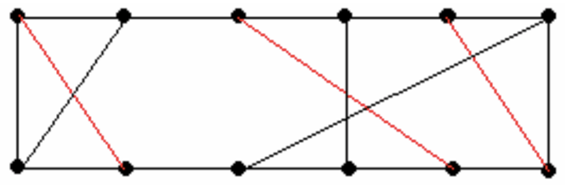
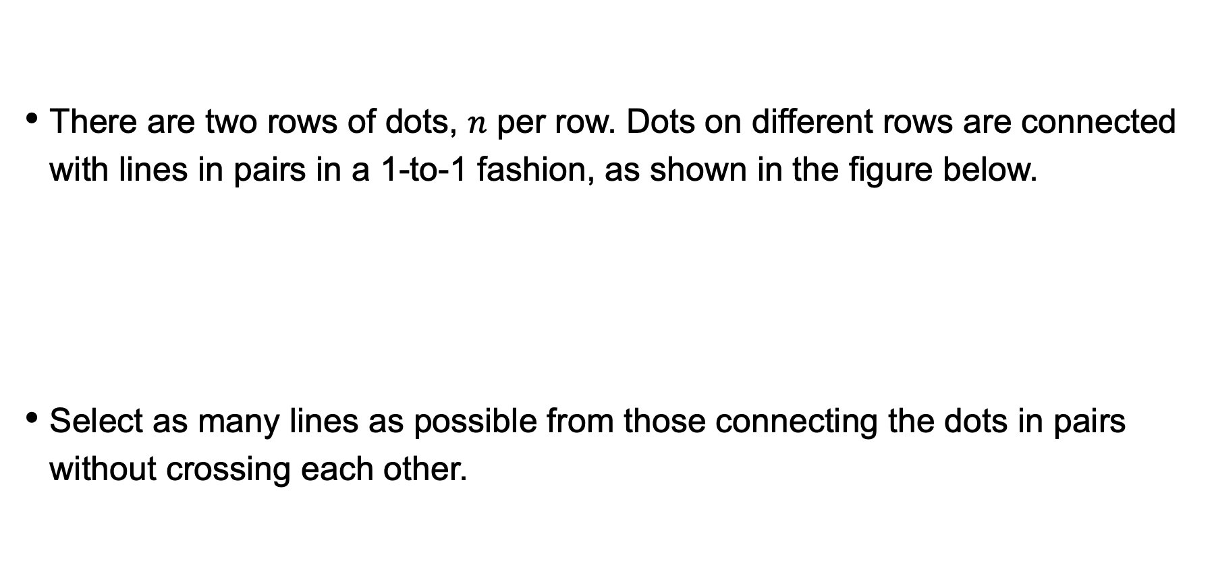
route problem
There are two rows of dots, $n$ per row. Dots on different rows are connected with lines in pairs in a 1-to-1 fashion, as shown in the figure below.
Select as many lines as possible from those connecting the dots in pairs without crossing each other.

Slide 33
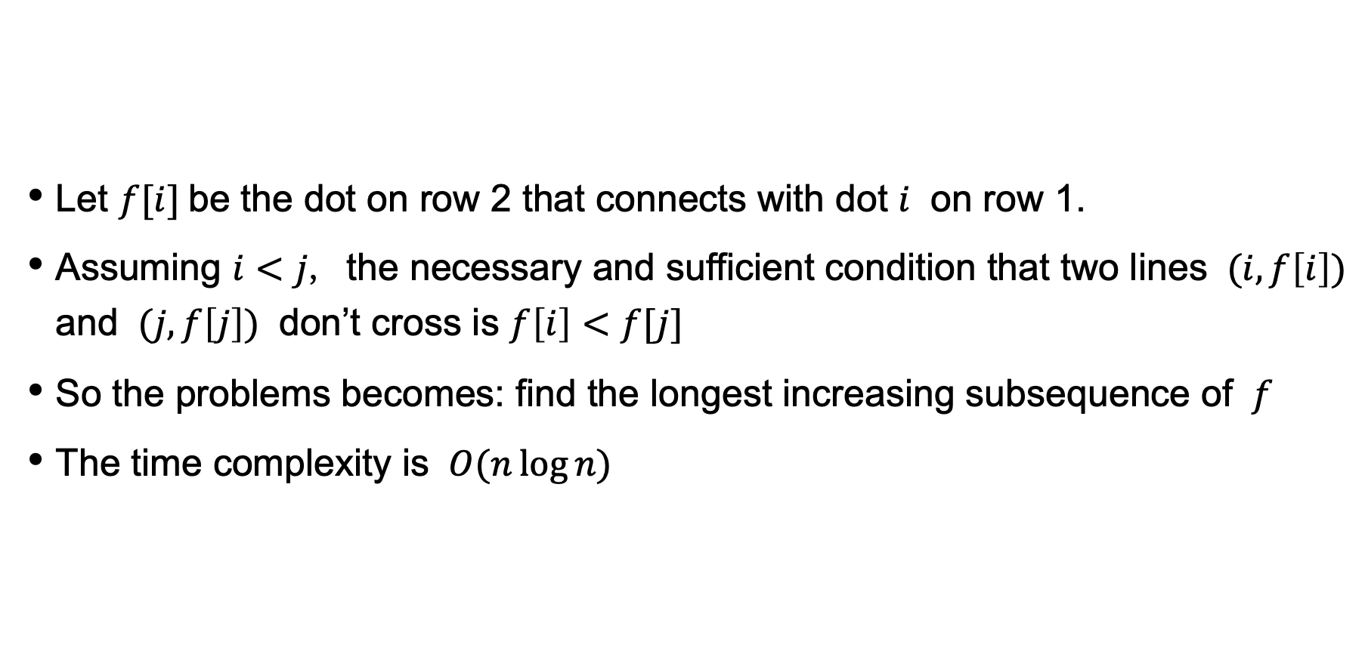
analysis
Let $f[i]$be the dot on row 2 that connects with dot $i$ on row 1.
Assuming $i<j$, the necessary and sufficient condition that two lines $(i,f\left[i\right])$ and $(j,f\left[j\right])$ don’t cross is $f\left[i\right]<f[j]$
So the problems becomes: find the longest increasing subsequence of $f$
The time complexity is $O(n\log{n})$

Slide 34
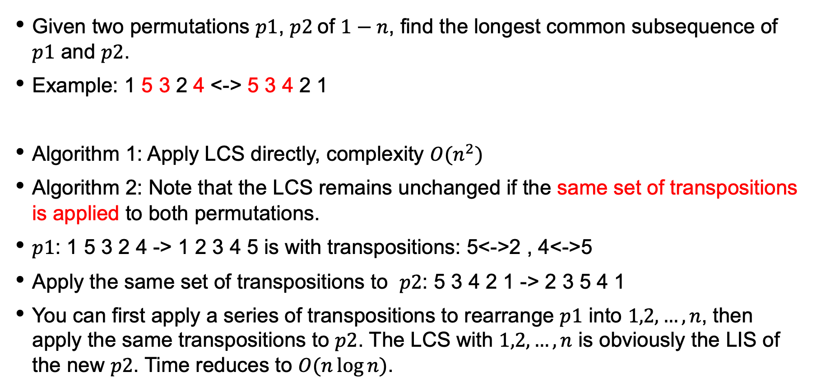
LCS of Two permutations
Given two permutations $p1$, $p2$of $1−n$, find the longest common subsequence of $p1$ and $p2$.
Example: 1 5 3 2 4 <-> 5 3 4 2 1
Algorithm 1: Apply LCS directly, complexity $O(n^{2})$
Algorithm 2: Note that the LCS remains unchanged if the same set of transpositions is applied to both permutations.
$p1$: 1 5 3 2 4 -> 1 2 3 4 5 is with transpositions: 5<->2 , 4<->5
Apply the same set of transpositions to $p2$: 5 3 4 2 1 -> 2 3 5 4 1
You can first apply a series of transpositions to rearrange $p1$ into $1,2,…,n$, then apply the same transpositions to $p2$. The LCS with $1,2,…,n$ is obviously the LIS of the new $p2$. Time reduces to $O(n\log{n})$.

Slide 35

Maximum sum of m sub-segments
Given a sequence $a_{1},a_{2},…,a_{n}$, find $m$ non-overlapping (can be adjacent) continuous subsequences with the largest sum.
For example: $m=2$, 1 2 -3 4 5 -6 7

Slide 36
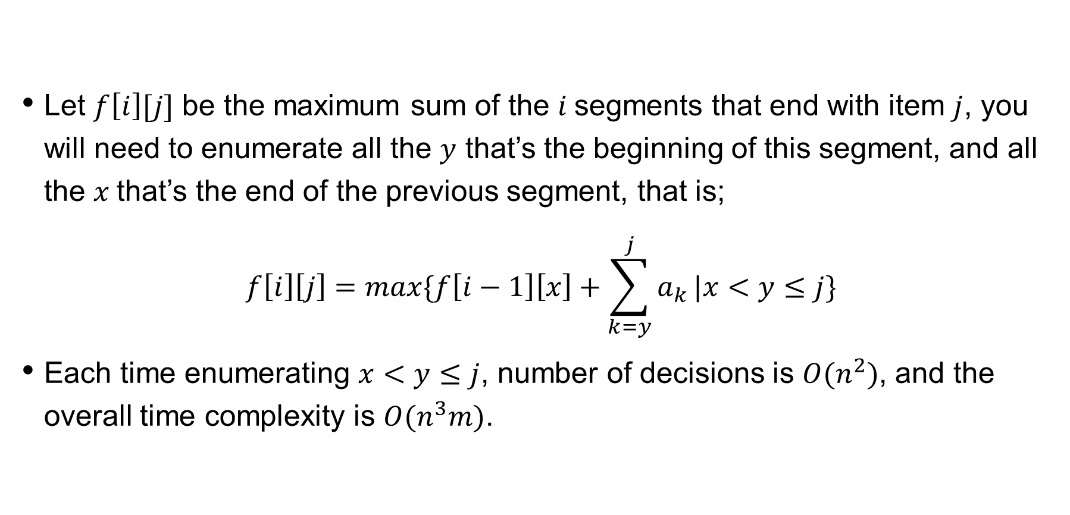
analysis
Let $f\left[i\right][j]$ be the maximum sum of the $i$segments that end with item $j$, you will need to enumerate all the $y$ that’s the beginning of this segment, and all the $x$that’s the end of the previous segment, that is;
$$f\left[i\right]\left[j\right]=max\{f\left[i−1\right]\left[x\right]+\sum_{k=y}^{j}{a_{k}}|x<y≤j\}$$
Each time enumerating $x<y≤j$, number of decisions is $O(n^{2})$, and the overall time complexity is $O(n^{3}m)$.

Slide 37
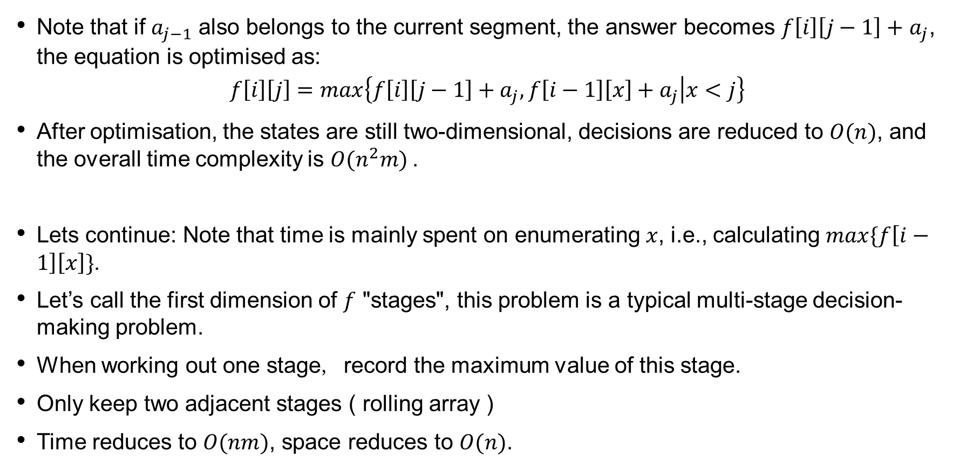
optimisation
Note that if $a_{j−1}$ also belongs to the current segment, the answer becomes $f\left[i\right]\left[j−1\right]+$ $a_{j}$, the equation is optimised as:
$$f\left[i\right]\left[j\right]=max\left\{f\left[i\right]\left[j−1\right]+a_{j},f\left[i−1\right]\left[x\right]+a_{j} | x<j\right\}$$
After optimisation, the states are still two-dimensional, decisions are reduced to $O(n)$, and the overall time complexity is $O(n^{2}m)$.
Lets continue: Note that time is mainly spent on enumerating $x$, i.e., calculating $max\{f\left[i−1\right]\left[x\right]\}$.
Let’s call the first dimension of $f$ "stages", this problem is a typical multi-stage decision-making problem.
When working out one stage, record the maximum value of this stage.
Only keep two adjacent stages ( rolling array )
Time reduces to $O(nm)$, space reduces to $O(n)$.

